Slide 1
TELCO-CUSTOMER CHURN PREDICTION PROJECT
- J. Raja Lakshmi

Slide 2
project about:
For telco customer companies ,it is important to attract new customers and at the same time avoid churns to grow their revenue.
There are different reasons that trigger customers to terminate their contracts.
In this project, I am trying to predict the reasons behind customers churn and what drives it , with the help of machine learning classification models.

Slide 3
THE DATASET EXPLAINED:
The dataset consist of complete customer details of Telco-customer service company.
The dataset contains 5986 entries with 22 columns where 4 continuous variables and 18 categorical variables.
The target variable is churn , which contains two classes – “Churned” and “Not churned” as “yes/no”.

Slide 4
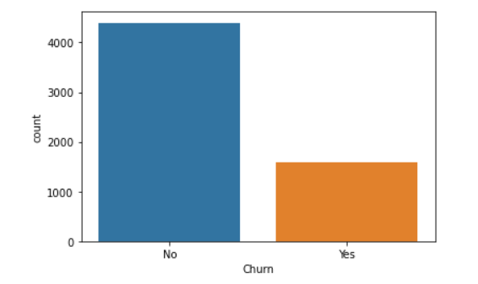
Data exploration
The plot shows a class imbalance between churners and non churners.
Tenure , contract duration terms and number of additional services are assumed to the most important driver for churn.
More expensive contracts lead to increased churn as the chances to save money by changing providers might be higher.
Senior citizens tend to churn less due to the extended effort associated with terminating contracts.

Slide 5
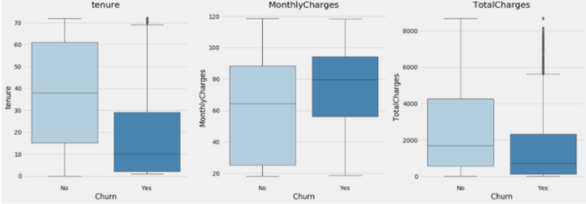
Churning customers have much lower tenure compared to non-churners .
Churning customers have higher monthly charges and lower interquartile range compared to that of non-churners.
Total Charges are the result of tenure and Monthly Charges, which are more insightful on an individual basis.

Slide 6
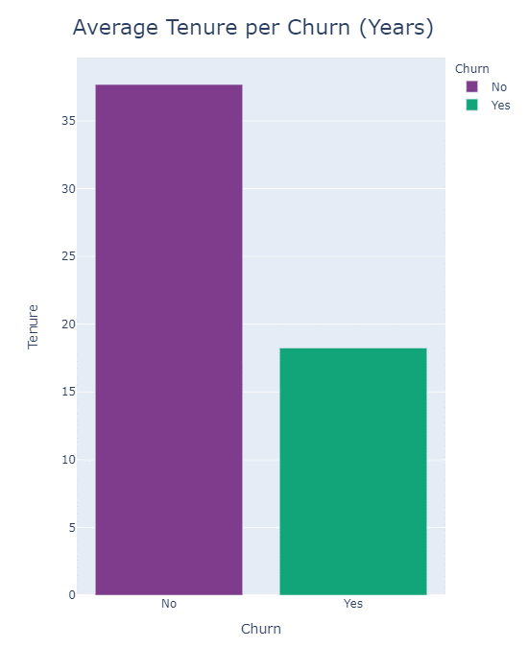
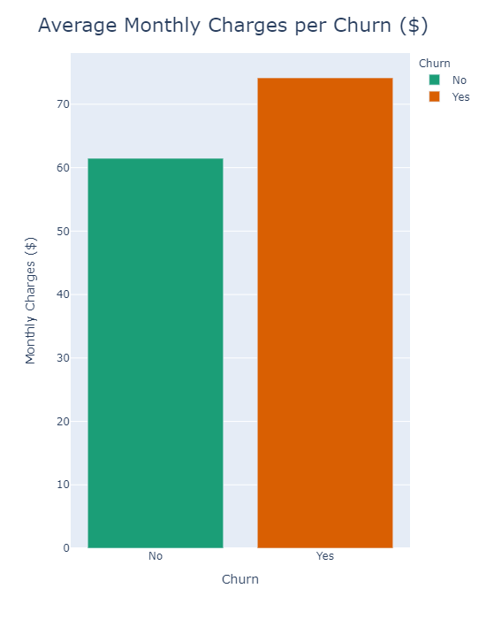
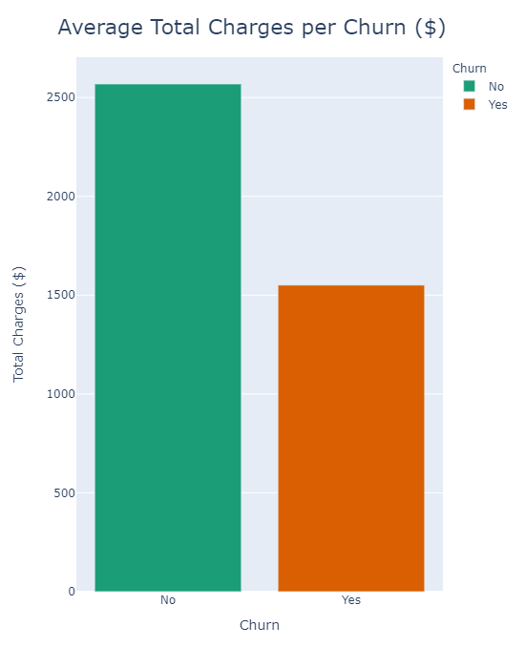
Senior citizens churn rate is much higher than non-senior churn rate.
Churn rate for month-to-month contracts much higher that for other contract durations.
Moderately higher churn rate for customers without partners.
Much higher churn rate for customers without children.
Payment method electronic check shows much higher churn rate than other payment methods.
Customers with Internet Service fiber optic as part of their contract have much higher churn rate.

Slide 7
CLASSIFICATION MODELS:
MODEL | ACCURACY | PRECISION | RECALL | F1-SCORE
LOGISTIC REGRESSION | 0.7418677859391396 | 0.751984126984127 | 0.758 | 0.7549800796812749
DECISION TREE | 0.6778593913955928 | 0.6965376782077393 | 0.684 | 0.6902119071644803
RANDOM FOREST | 0.7324239244491081 | 0.7494908350305499 | 0.736 | 0.7426841574167506
Based on the model comparison , the overall accuracy is higher for Logistic Regression model with 74% accuracy. Where decision tree classifier accuracy is 67% and Random Forest classifier is giving 73% accuracy.
Hence we can use Logistic Regression model to classify this Telco-customer churn Prediction dataset.

